Slide 1

UNIT -1

Slide 2

The internet in India is growing rapidly. It has given rise to new opportunities in every field we can think of be it entertainment, business, sports or education.
There’re two sides to a coin. Internet also has it’s own disadvantages is Cyber crime- illegal activity committed on the internet.

Slide 3

Crime committed using a computer and the internet to steal data or information.

Slide 4
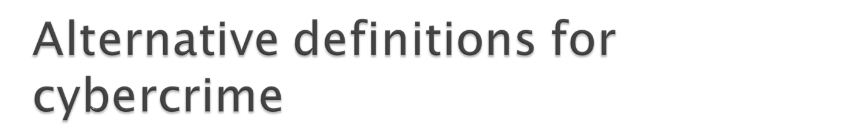
Any illegal act where a special knowledge of computer technology is essential for its perpetration, investigation or prosecution
Any traditional crime that has acquired a new dimension or order of magnitude through the aid of a computer, and abuses that have come into being because of computers
Any financial dishonesty that takes place in a computer environment.
Any threats to the computer itself, such as theft of hardware or software, sabotage and demands for ransom

Slide 5
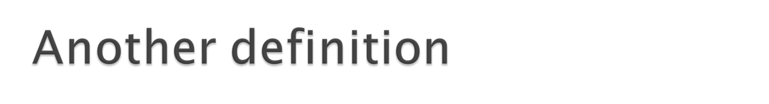
“Cybercrime (computer crime) is any illegal behavior, directed by means of electronic operations, that target the security of computer systems and the data processed by them”.
Hence cybercrime can sometimes be called as computer-related crime, computer crime, E-crime, Internet crime, High-tech crime….

Slide 6
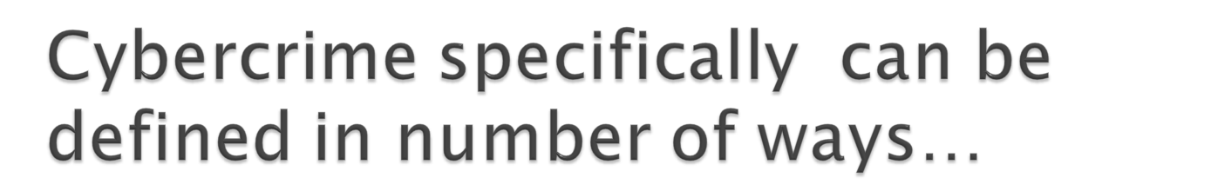
A crime committed using a computer and the internet to steal a person’s identity(identity theft) or sell contraband or stalk victims or disrupt operations with malevolent programs.
Crimes completed either on or with a computer
Any illegal activity through the Internet or on the computer.
All criminal activities done using the medium of computers, the Internet, cyberspace and the WWW.

Slide 7
Cybercrime refers to the act of performing a criminal act using cyberspace as communication vehicle.
Two types of attacks are common:
  Techno- crime
  Techno – vandalism

Slide 8
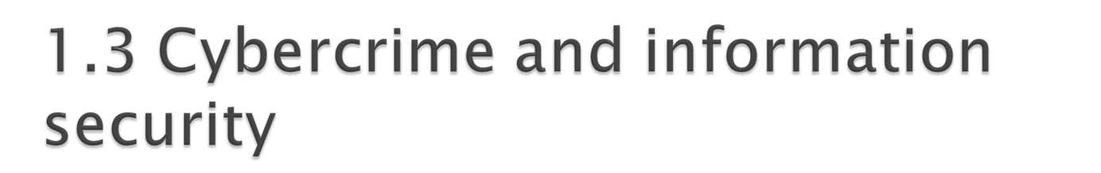
Lack of information security give rise to cybercrime
Cybersecurity

Slide 9
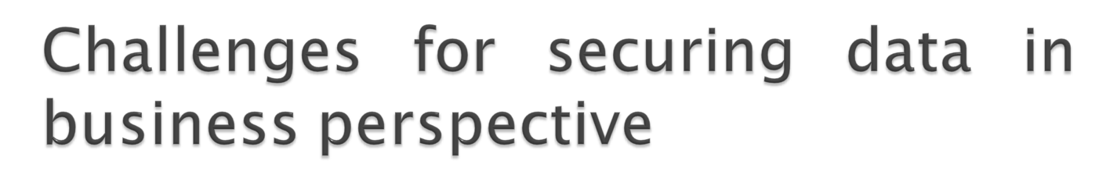
Cybercrime occupy an important space in information security due to their impact.
Most organizations do not incorporate the cost of the vast majority of computer security incidents into their accounting
The difficulty in attaching a quantifiable monetary value to the corporate data and yet corporate data get stolen/lost
Financial loses may not be detected by the victimized organization in case of Insider attacks : such as leaking customer data

Slide 10
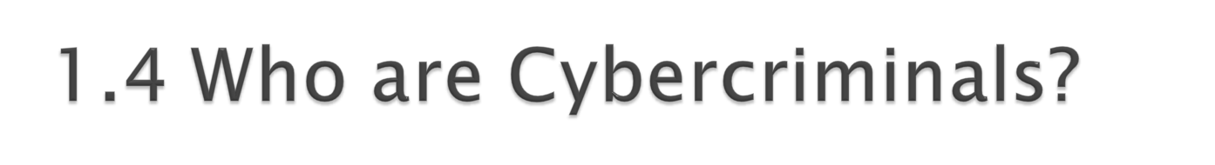
Are those who conduct acts such as:
  Credit card fraud
  Cyberstalking
  Defaming another online
  Gaining unauthorized access to computer systems
  Ignoring copyrights
  Software licensing and trademark protection
  Overriding encryption to make illegal copies
  Software piracy
  Stealing another’s identity to perform criminal acts

Slide 11
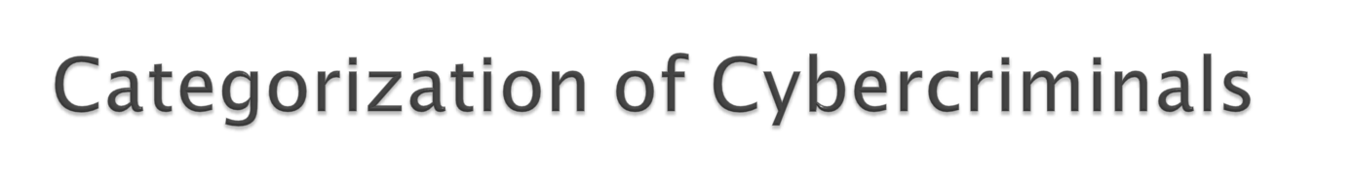
Type 1: Cybercriminals- hungry for recognition
  Hobby hackers
  IT professional(social engineering):
  Politically motivated hackers :
  Terrorist organizations

Slide 12

  Psychological perverts
  Financially motivated hackers
  State-sponsored hacking

Slide 13
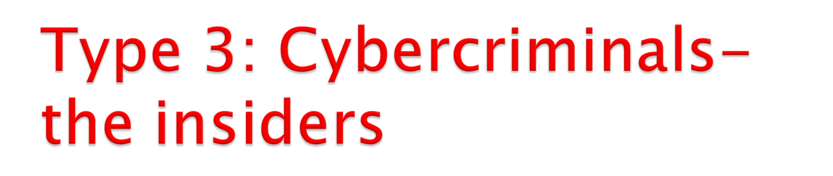
  Disgruntled or former employees seeking revenge
  Competing companies using employees to gain economic advantage through damage and/ or theft.
  Motives behind cyber crime:

Slide 14
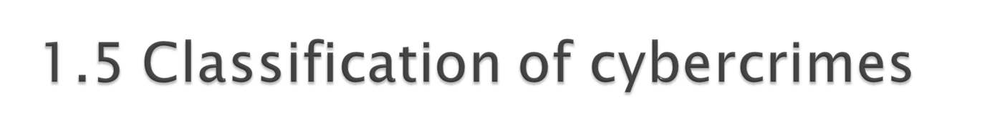
Cybercrime against an individual
Cybercrime against property
Cybercrime against organization
Cybercrime against Society
Crimes emanating from Usenet newsgroup

Slide 15
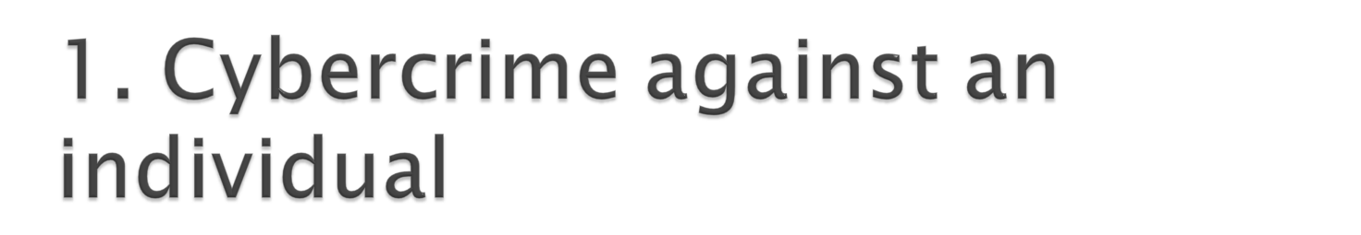
Electronic mail spoofing and other online frauds
Phishing, spear phishing
spamming
Cyberdefamation
Cyberstalking and harassment
Computer sabotage
Pornographic offenses
passwordsniffing

Slide 16
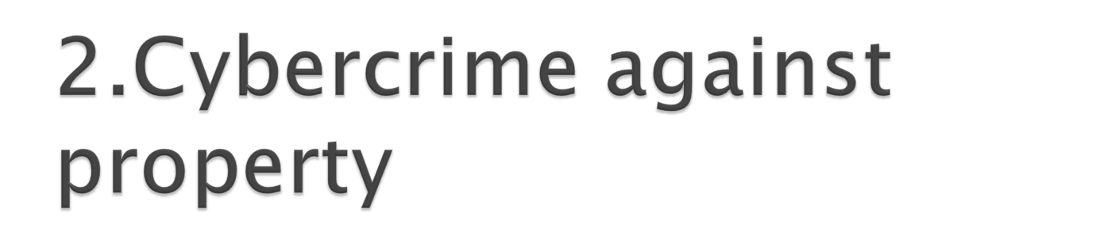
Credit card frauds
Intellectual property( IP) crimes
Internet time theft

Slide 17
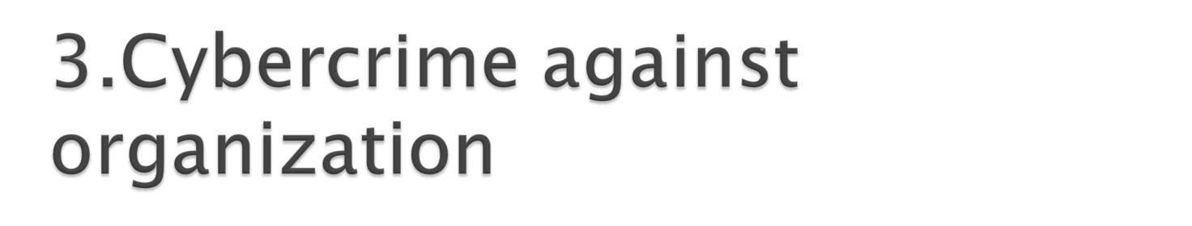
Unauthorized accessing of computer
Password sniffing
Denial-of-service attacks
Virus attack/dissemination of viruses
E-Mail bombing/mail bombs
Salami attack/ Salami technique
Logic bomb
Trojan Horse
Data diddling
Industrial spying/ industrial espionage
Computer network intrusions
Software piracy

Slide 18
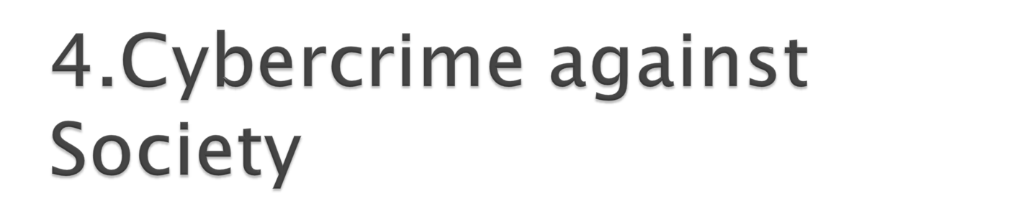
Forgery
Cyberterrorism
Web jacking

Slide 19
The categories of vulnerability that hackers typically search for are the following
1. Inadequate border protection
2. Remote access server
3. Application Servers
4. Misconfigured systems

Slide 20
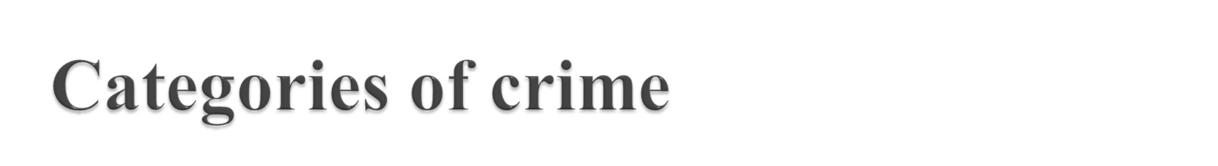
1. The target of the crime
Individuals
Property
Organizations
2. Whether the crime occurs as a single event or series of event

Slide 21
Crimes targeted at Individuals: the goal is to exploit human weakness
Crimes targeted at property: includes stealing mobile devices
Crimes targeted at organizations: Cyberterrorism
Single event of crime: It is a single wevent from the perspective of the victim
Series of events: involves attacker interacting with the victims repetitively

Slide 22

Criminals plan
1. Passive attack:
gains information about target
Breach of confidentiality
2. Active attack:
alter the system
Availability, integrity and authenticity

Slide 23
Attacks can be categorized as
Inside attack: Security perimeter
Outside attack : Internet or RAS

Slide 24
The following phases are involved in planning cyber crime
1.Reconnaissance: Footprinting
Passive attack involves gathering information
Active attack involves confirming the information gathered in passive attack
2. Scanning and scrutinizing the gathered information
Port scanning
Network scanning
Vulnerability scanning
3. Launching the attack: Gaining and maintaining the system access

Slide 25

Social Engineering is the “technique to influence” and “persuation to deceive” people
It is an art of exploiting the trust of people
The goal of social engineer is to fool someone into providing valuable information or access to that information

Slide 26
Classification of social engineering
1. Human-based social engineering
Impersonating an employee or valid user
Posing as an inportant user
Using a third person
Calling technical support
Shoulder surfing
Dumpster diving
2. Computer-based social engineering
Fake E-mails
E-mail attachments
Pop-up windows

Slide 27
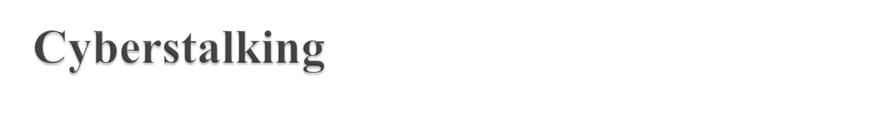
Types of stalkers
Online Stalker: Uses internet
Offline Stalker: uses Traditonal methods
How stalking works?
Gathering personal information
Establish a contact through telephone or cell phone
Establish a contact through e-mails
Send repeated e-mails
Posts victims personal information on any website related to illicit services
Stalkers subscribe/ register e-mail accounts of victims to illegal websites

Slide 28
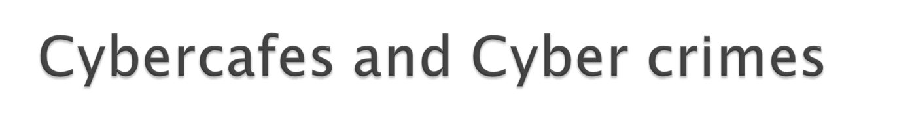
Public computers available in cybercafes,hold two types of risks
Keyloggers/spyware
Shoulder surfing
Cybercriminals prefer cybercafes to carry out their activities

Slide 29
A recent survey reveals the following facts about the cybercafes:
1. Pirated softwares are installed
2. Antivirus software is not updates
3. Deepfreeze
wipes all the activities carried out on the computer.
Present challenges to the crime investigators
4. Annual maintenance contract found not in a place for servicing the system
5. Illegal websites are not blocked
6. Cybercafe owners have very less awareness
7.IT Governance guidelines are not provides to cybercafe owners
8. Cyber cell wing donot make periodic visits to cyber cafe

Slide 30
Few tips for safety and security while using the computer in cybercafes
1. Always logout
2. Stay with the computer
3. Clear history and temporary files
4. Be alert
5. Avoid online financial transactions
6. Change passwords
7. Virtual keyboard
8. Security warnings

Slide 31
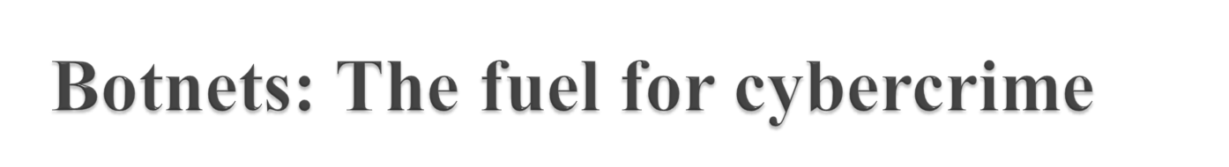
Botnet (Zombie network) is the network of computers infected with a malicious program that allows cybercriminals to control the infected machines remotely without users knowledge

Slide 32
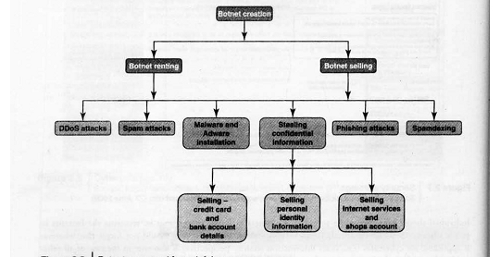

Slide 33
One can ensure the following to secure their system from becoming a part of botnet:
1. Use antivirus and anti-spyware software
2. Set the OS to download and install security patches automatically
3. Use a firewall
4.Disconnect from the internet when you are away from the computer
5. Download the freeware only from the websites that are known and trustworthy
6. Check regularly the folders in the mailox for those you did not send.
7. Take an immediate action if your system is infected

Slide 34

Attack vector is a path or means by which an attacker can gain access to a computer or to a network server to deliver a payload or malicious outcome.
Following describes how most of the attack vectors are launched
1. Attack by e-mail
2. Attachments
3. Attack by deception
4. Hackers
5. Attack by webpages
6. Attack of the worms
7. Malicious macros
8. Foistware
9. Viruses

Slide 35

Cloud computing is internet-based development and use of computer technology used for hosted services delivered over the internet
A cloud service has three distinct characteristics
1. it is sold on demand
2. it is elastic in terms of usage
3. the service is fully managed by the provider

Slide 36
Advantages of Cloud computing
1. Applications and data can be accessed from anywhere at anytime
2.It could bring hardware costs down
3. Donot have to buy set of software or software licenses
4. Donot have to rent a physical space
5. Would be able to save money
Types of services
1. Infrastructure –as-a-service(IaaS)
2. Platform–as-a-service(PaaS)
3. Software–as-a-service(SaaS)

Slide 37
Cybercrime and cloud computing
Following are the risks accociated with cloud computing environment
Elevated user access
Regulatory complaince
Location of data
Segregation of data
Recovery of data
Information security violation reports
Long term viability

